Slide 1
COMP 4621
Tutorial #2
Spring 2015

Slide 2
Outline
HTTP: Concept & Programming
TCP: Concept & Programming
Practice & Q&A

Slide 3
Outline
HTTP: Concept & Programming
TCP: Concept & Programming
Practice & Q&A

Slide 4

A Question
How to kill time in a boring tutorial?

Slide 5

Time for internet surfing!

Slide 6

Before you really start to do it…
What really happens when you
open a website, say, Facebook?

Slide 7
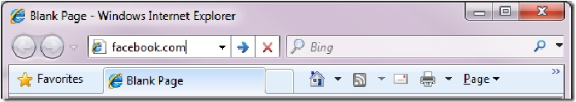

What really happens…
You enter a URL into the browser
The browser looks up the IP address for the domain name
IP: 208.87.149.250

Slide 8

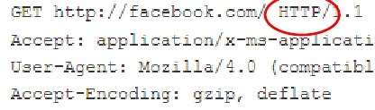
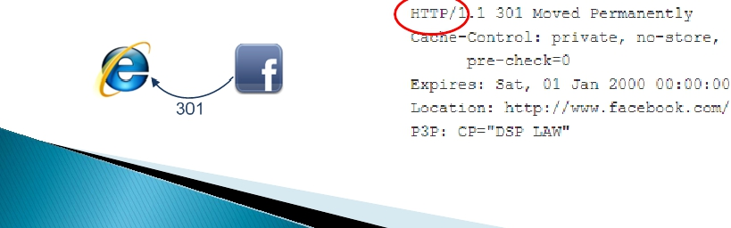
What really happens… (Cont.)
The browser sends a HTTP request to the web server
The Facebook server responds with a permanent redirect,why?

Slide 9

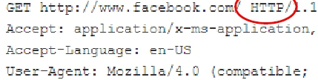

What really happens… (Cont.)
The browser follows the redirect
6. The server “handles” the request

Slide 10

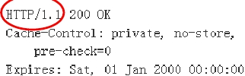
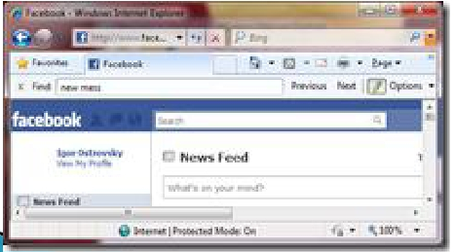
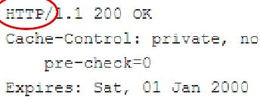
What really happens… (Cont.)
The server sends back a HTML response
The browser begins rendering the HTML

Slide 11
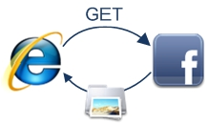
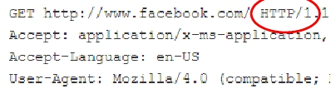
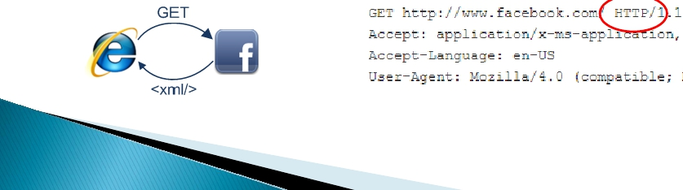
What really happens… (Cont.)
The browser sends requests for objects embedded in HTML
The browser sends further asynchronous (AJAX) requests

Slide 12
What really happens…
8/10 steps make use of HTTP.
HTTP is important, especially when you want to kill time during the lab.
Discover more details on http://igoro.com/archive/what-really-happens-when-you-navigate-to-a-url/

Slide 13
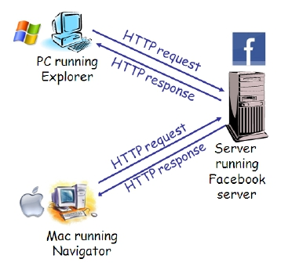
HTTP Overview
HTTP: Hyper-Text Transfer Protocol
Web’s application layer protocol
TCP-based, Client/server model
    Client: browser that requests, receives, “displays” Web objects
    Server: web server that sends objects in response to requests
Status code
  404 – Not Found
  301 – Move permanently

Slide 14
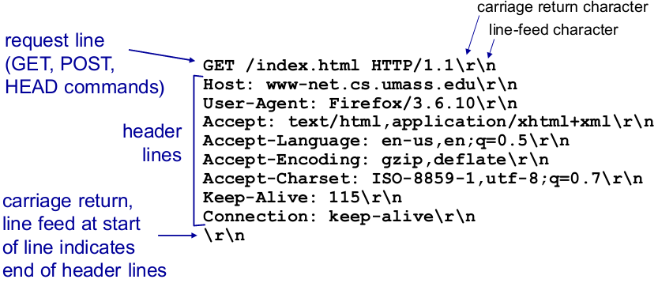
HTTP Programming: Example
In this example, we will:
  establishes a TCP connection with a standard HTTP server
  sends HTTP request to the server
  downloads the webpage to the user-end
GET / HTTP/1.1\r\n
Host: course.cse.ust.hk\r\n

Slide 15
HTTP Programming: Example
package lab2;
import java.io.*;
import java.net.*;
public class HttpClient {
public static void main(String argv[]) throws Exception {
// input url
String urlWebPage;
BufferedReader inFromUser = new BufferedReader(new InputStreamReader(System.in) );
System.out.println("Please input the URL of the webpage:");
urlWebPage = inFromUser.readLine();
// create socket
System.out.println();
Socket clientSocket = new Socket(urlWebPage, 80);
Read user input from keyboard
Create TCP socket
What is the difference with UDP socket?

Slide 16
HTTP Programming: Example
// prepare input/output stream
DataOutputStream outToServer = new DataOutputStream(clientSocket.getOutputStream() );
DataInputStream inFromServer = new DataInputStream(clientSocket.getInputStream() );
// attach output stream to a local file
File htmlFile = new File("index.html");
DataOutputStream outToFile = new DataOutputStream(new FileOutputStream(htmlFile) );
// write HTTP req
outToServer.writeBytes("GET / HTTP/1.1\n");
outToServer.writeBytes("Host: " + urlWebPage + "\n");
outToServer.writeBytes("\n");
Prepare input & output stream
Sent HTTP req to server

Slide 17
HTTP Programming: Example
Read from svr
Write to disk
Until ?
// prepare to buffer for recv
int recv = 0;
int bufferSize = 1024;
byte[] buffer = new byte[bufferSize];
// recv from svr
while ( (recv = inFromServer.read(buffer, 0, bufferSize)) != -1) {
outToFile.write(buffer, 0, recv); // write to file
}
// flush and close stream
outToFile.flush();
outToFile.close();
//close socket
clientSocket.close();
System.out.println("The web page has been downloaded as index.html.");
} }
Clear up

Slide 18
HTTP Programming: Practice
run this example by yourself to download a webpage to your local disk. See what is included in that response
  mkdir lab2, create HttpClient.java
  javac HttpClient.java // compile the java file;
  java HttpClient // run the client program;
Try “facebook.com” and “course.cse.ust.hk”, what is the difference?

Slide 19
Outline
HTTP: Concept & Programming
TCP: Concept & Programming
Practice & Q&A

Slide 20
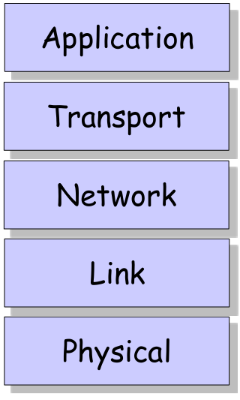
Internet Protocol Stack
HTTP, FTP, SMTP
TCP, UDP
IP
Ethernet, PPP
Bits “on the wire”

Slide 21
TCP Overview
TCP: Transmission Control Protocol
Point-to-point: One sender, one receiver
Connection-oriented, reliable, in-order byte-stream
  handshake
  Congestion control
  Flow control
  Re-transmission
Lots of applications rely on TCP: HTTP, FTP, SMTP,…

Slide 22
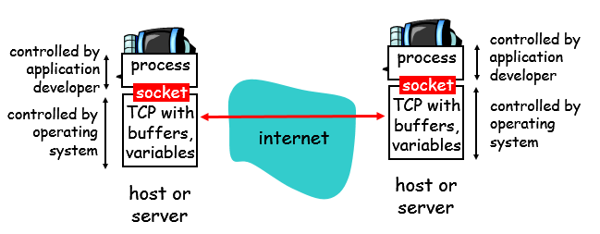
TCP Programming: Socket
TCP: reliable transfer Protocol of bytes from one process to another.
Network Socket: an endpoint of an inter-process communication flow across a computer network.
Socket API: an API provided by the operating system, that allows application programs to control and use network sockets.

Slide 23
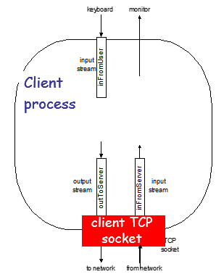
TCP Programming: Stream
A stream is a sequence of characters that flow into or out of a process.
An input stream is attached to some input source for the process, e.g., keyboard or socket.
An output stream is attached to an output source, e.g., monitor or socket.

Slide 24
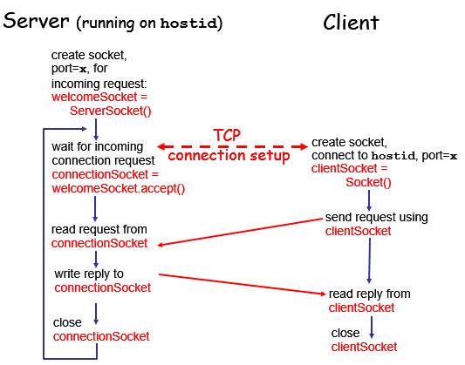
TCP Programming: Steps

Slide 25
TCP Programming: Example 1
In this example, we will:
1) client reads line from standard input, sends to server via socket.
2) server reads line from socket
3) server converts line to uppercase, sends back to client
4) client reads, prints modified line from socket

Slide 26
TCP Programming: Example 1 (Server)
package lab2;
import java.io.*;
import java.net.*;
public class TCPServer_msg {
public static void main(String argv[]) throws Exception {
String clientSentence;
String capitalizedSentence;
// create svr socket on port 6789
int nPort = 6789;
ServerSocket welcomeSocket = new ServerSocket(nPort);
Create a Server socket, listen on port 6789

Slide 27
TCP Programming: Example 1 (Server)
while (true) {
System.out.println("msg svr is listening on"+nPort+"...");
// block until a new connection is accepted
Socket connectionSocket = welcomeSocket.accept();
// get input/output stream
BufferedReader inFromClient = new BufferedReader( new InputStreamReader(connectionSocket.getInputStream()));
DataOutputStream outToClient = new DataOutputStream( connectionSocket.getOutputStream());
// read from client
clientSentence = inFromClient.readLine();
System.out.println("receive from client: " + clientSentence);
// change to upper case
capitalizedSentence = clientSentence.toUpperCase() + '\n';
// write back to client
outToClient.writeBytes(capitalizedSentence);
}}}
Keep listening on port 6789
Prepare input & output stream
Read from client,
To upper case,
Send back to client

Slide 28
TCP Programming: Example 1 (Client)
package lab2;
import java.io.*;
import java.net.*;
public class TCPClient_msg {
public static void main(String argv[]) throws Exception {
String sentence;
String modifiedSentence;
// prepare input stream from keyboard
BufferedReader inFromUser = new BufferedReader(new InputStreamReader( System.in));
// create sockets
Socket clientSocket = new Socket("localhost", 6789);
Prepare input stream from keyboard
Create TCP socket

Slide 29
TCP Programming: Example 1 (Client)
Prepare input & output stream
// get input/output stream
DataOutputStream outToServer = new DataOutputStream(clientSocket.getOutputStream());
BufferedReader inFromServer = new BufferedReader(new InputStreamReader(clientSocket.getInputStream() ) );
// read from standard input
sentence = inFromUser.readLine();
// send to svr
outToServer.writeBytes(sentence + '\n');
// block until receive from server
modifiedSentence = inFromServer.readLine();
// print out received msg
System.out.println("FROM SERVER: " + modifiedSentence);
clientSocket.close();
} }
Read from user input,
Send to svr,
Then wait to response

Slide 30
TCP Programming: Practice 1
Try this example on your machine
  Note: svr need to be started before client try to connect to it
Questions:
  What is the difference btw this example and UDP example we did in last lab?
  Can multiple clients connect to this server simultaneously?
    If yes, how to identify each connection?

Slide 31
TCP Programming: Example 2
In this example, we will:
  creates a file and input some content
  start the TCPClient and input the file’s name
  transfer the content of the file to the server and save it in a file.

Slide 32
TCP Programming: Example 2 (Server)
package lab2;
import java.io.*;
import java.net.*;
public class TCPServer_file {
public static void main(String[] argv) throws Exception {
// create svr socket on specified port
int PORT = 9876;
ServerSocket serverSocket = new ServerSocket(PORT);
System.out.println("Server is running.....");
// client socket to recv
Socket socket = null;
Create a server socket on port 9876

Slide 33
TCP Programming: Example 2 (Server)
while (true) {
//block until new connection is accepted
socket = serverSocket.accept();
// prepare buff to recv
int recv = 0;
int bufferSize = 1024;
byte[] buffer = new byte[bufferSize];
// create input stream from accepted socket
DataInputStream fileStream = new DataInputStream( new BufferedInputStream(socket.getInputStream()));
// get user name and file name from 1st line
String fileMsg = fileStream.readLine();
int userNameIndex = fileMsg.indexOf(':');
String userName = fileMsg.substring(0, userNameIndex);
String fileName = fileMsg.substring(userNameIndex + 1);
System.out.println(fileName);
System.out.println("New connection accepted from: " + username + "," + socket.getInetAddress() + ":" + socket.getPort());
Block until a connection is established
Read 1st line from client, try to parse user name and file name from it

Slide 34
TCP Programming: Example 2 (Server)
// create new file to write(filename: username_port_filename)
File recvFile = new File(userName + "_" + socket.getPort() + "_" + fileName);
// attach this file to an output stream
DataOutputStream outputFile = new DataOutputStream( new FileOutputStream(recvFile));
// continue to read from input stream until end
while ((recv = fileStream.read(buffer, 0, bufferSize)) != -1) {
outputFile.write(buffer, 0, recv); // write to file
}
// flush and close streams
outputFile.flush();
outputFile.close();
socket.close();
System.out.println("File " + fileName + " from user " + userName + " has been transfered!");
} } }
Create a file and attach it to an output stream
While read from client, write to file
Clear up & close

Slide 35
TCP Programming: Example 2 (Client)
package lab2;
import java.io.*;
import java.net.*;
public class TCPClient_file {
public static void main(String argv[]) throws Exception {
// create input stream from standard input
BufferedReader inFromUser = new BufferedReader(new InputStreamReader( System.in));
System.out.println("Input the ip you want to send to:");
// get ip address
String ip = inFromUser.readLine();
InetAddress IPAddress = InetAddress.getByName(ip);
System.out.println("Connecting to " + IPAddress.toString());
// create a socket
int nPort = 9876;
Socket clientSocket = new Socket(ip, nPort);
Read ip from user input
Create a socket with dst port 9876

Slide 36
TCP Programming: Example 2 (Client)
// get system user name
String username = System.getProperty("user.name");
// get file to transfer
System.out.println("Input the name of the file you want to transfer:");
String fileName = inFromUser.readLine();
// attach file stream to socket output stream
DataOutputStream outToServer = new DataOutputStream(
new BufferedOutputStream(clientSocket.getOutputStream()));
DataInputStream fileInputStream = new DataInputStream(
new BufferedInputStream(new FileInputStream(fileName)));
// write 1st line(format=username:filename)
outToServer.writeBytes(username + ":" + fileName + "\n");
outToServer.flush(); // send to svr
Get user name & file to transmit
Prepare input & output stream
Send user name & file name to svr

Slide 37
TCP Programming: Example 2 (Client)
keep reading from file and send to svr until the end of file
// read from file and send to svr
int bufferSize = 1024;
byte[] buffer = new byte[bufferSize];
int read = 0;
if (fileInputStream != null) {
while ((read = fileInputStream.read(buffer)) != -1) {
outToServer.write(buffer, 0, read);
}
// flush and close socket
outToServer.flush();
fileInputStream.close();
clientSocket.close();
System.out.println("The file " + fileName + " has been tranfered!");
} } }
Clear up

Slide 38
TCP Programming: Practice 2
Run the sample code by yourself
  Compile with javac
  Run with java
  Note
    The IP address of local machine is 127.0.0.1
    Svr need to be started before client

Slide 39
Outline
HTTP: Concept & Programming
TCP: Concept & Programming
Practice & Q&A

Slide 40
Download links
https://www.dropbox.com/sh/lokjgr6xbf6filc/AAAZaqVNLVI19RD6LtYcrOAHa?dl=0

